Slide 1
NON DESTRUCTIVE TESTING

Slide 2
Testing Method
Destructive testing | Non Destructive testing
1 The specimen is destroyed | 1 The specimen is not destroyed
2. All components can’t be tested | 2. All components can be tested
3.Tests are more time consuming | 3.Tests are more rapid, not time consuming
4.Testing during operation is not possible | 4.Testing during operation is not possible
5.Test results are quantitative. | 5.Test results are qualitative

Slide 3
Types of Defect:
Surface crack
Surface irregularities
Internal Cracks
Presence of impurities or air bubble
Variation in dimension
Creep: Permanent deformation of a component when subjected to constant load for a long time.
Fatigue: It is failure of a material due to repeated cycle of loading and unloading

Slide 4
Objectives of NDT
To detect flaws during the manufacturing of component .
To detect flaws of finished component which will enhance their performance and reliability.
To detect flaws which may develop during operation which will ensure that there is no reduction in the rate of production.
To increase the safety.

Slide 5
Methods of NDT
Liquid or dye penetrate test
Radiography Method
a) X-ray radiography
b)ϒ rays radiography
Ultrasonic inspection
Magnetic particle inspection
Visual inspection
Eddy current inspection
Thermography

Slide 6
X-ray radiography
X ray have high penetration power. The smaller the wavelength , larger is the penetration power.
When x rays are passed through metals, the intensity decreases due to absorption.
Larger the distance travelled by x rays in the metal, larger is the decrease n the intensty and smaller is the transmitted intensity.
The decrease in intensity also depends on the density of the materal.
If x rays are passed through a metalpiece containing flaw, larger intensity of x rays will be transmitted through that region due to small thickness of metal in that region compared to surrounding region.
The x ray film krpt behind the object will become darker in the regionof the flaw . This is similar to the x rays of human body in which the bones appear transparent on the film as they block the x rays and remaining region are darker. This method is able to reveal the flaws hidden in the interior of the component.
The x ray image is taken for only one position of the source, the flaw can be detected but its positon cannot be located.

Slide 7
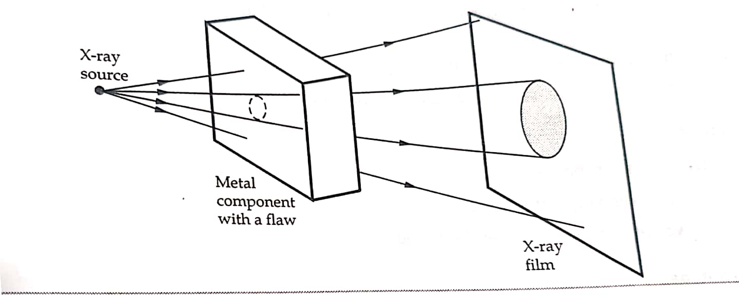

Slide 8
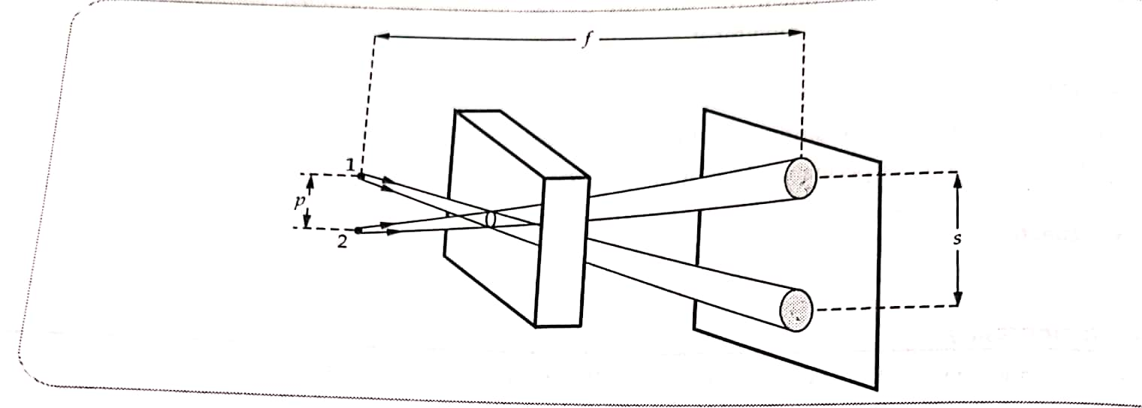
To locate the position of the flaw, the image is taken for two position of the source as shown in fig. below.
d=f×s ⁄s+p
d=depth of flaw ; f=dist bet source and film ;
p=dist bet two positions of source ; s=dist bet two image

Slide 9
Advantages :
Hidden flaws can be detected.
Inspection takes place little time.
A wide variety of materials can be tested.
Disadvantages :
Is is expensive compare to other methods.
Inspection has to be carried out in an isolated place as long exposure to x rays is harmful to human beings.
Very small flaws cannot be detected.

Slide 10
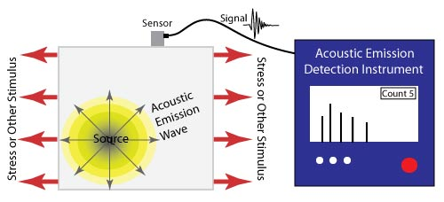
Acoustic Emission Technique

Slide 11
A localized external force such as mechanical load or rapid temp. or pressure is applied to the part of the material being tested.
A small material displacement is produced inside the material.
This results into generation of stress waves inside the material in the form of short-lived, high frequency elastic waves.
These stress waves are detected by sensors that have been attached to the material.
The stress waves show discontinuities in the material where flaws or irregularities inside the materials.
When multiple sensors are used , the resulting data can be analyses by CRO to evaluate location of discontinuities in the part.

Slide 12
Ultrasonic flaw detection technique uses the property of ultrasonic waves that thet get partially reflected from any boundary seperating between two media having different densities.
An ultrasonic pulse is transmitted into the specimen from one end by an ultrasonic transducer like quartz crystal which also performs the function of reciever.
In absence of any flaw, the pulse is reflected from the other end of the specimen and two pulses are displayed on C.R.O as shown in fig in next slide
Ultrasonic Inspection Method

Slide 13
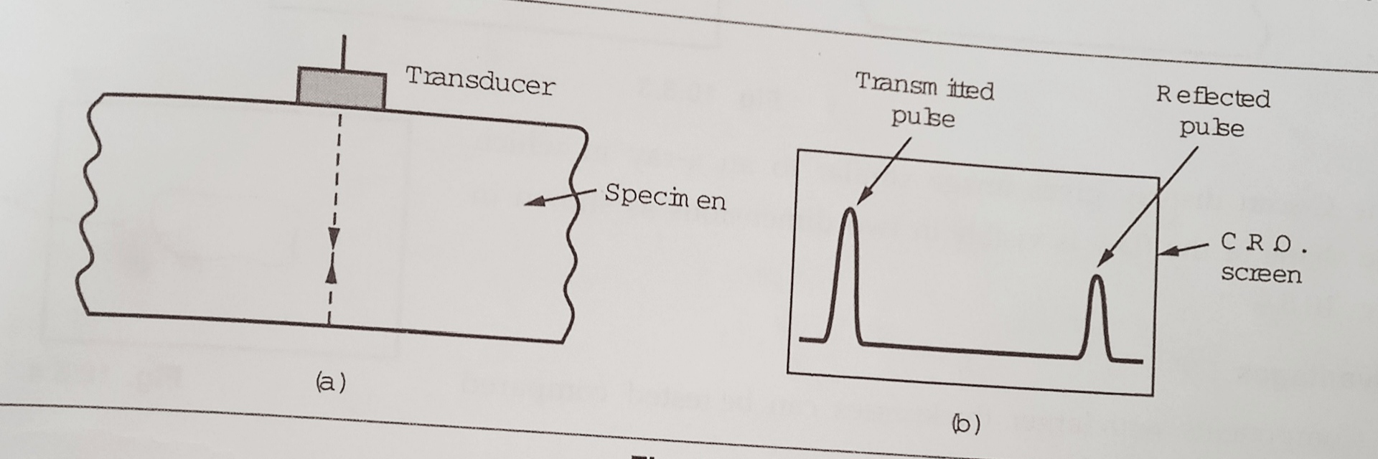
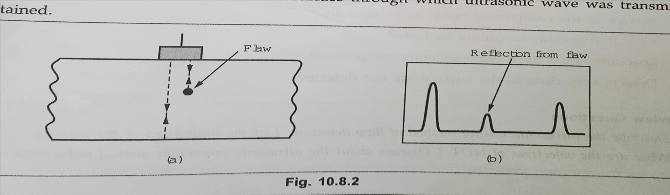

Slide 14
The distance between two pulses on the pulses on the C.R.O screen can be calibrated in terms of the distance travelled by the ultrasonic wave in the specimen.
If there is a flaw, an additional peak will be seen between the transmitted pulse and pulse reflected from the other end.
The position and dimensions of the flaw can be obtained by moving the transducer on the specimen surface and finding the distance of the flaw from different location on the specimen surface.
The ultrasonic flaw detection method is used in automobile, aircraft, railway and shipping industries to test machine parts and rails for flaws.

Slide 15
Advantages:
Components with larger thicknesses can be tested compared to x ray radiography.
This method is more accurate.
Low cost.
High speed.
Small flaws can be detected.
Disadvantage:
Surface of the component needs to be smooth.
Very thin specimen cannot be tested.
Specimen must have homogeneous composition.
Defects very close to surface are not detected.

